Slide 1

Beginner’s Guide to Git and GitHub
~Working in the Browser only~
Conrad Leonard and Kylie Davies
30 July 2025

Slide 2
Topic outline
Why GitHub?
Raising an issue
Making a branch
Make a simple document in markdown using Google docs
Submitting a pull request
Comparing and merging a pull request
Branch hygiene

Slide 3
Why Git and GitHub?
Why? Because of an exponential growth in the need for software engineers to work together on development of complex software.
Git and GitHub are not the same thing:
Git is a distributed version control system - a tool used by software developers to track changes to their code over time, allowing them to collaborate effectively and manage different versions of their projects.
GitHub is a developer platform that allows developers to create, store, manage, and share their code. It uses Git to provide distributed version control and GitHub itself provides access control, bug tracking, software feature requests, task management, continuous integration, and wikis for every project.

Slide 4
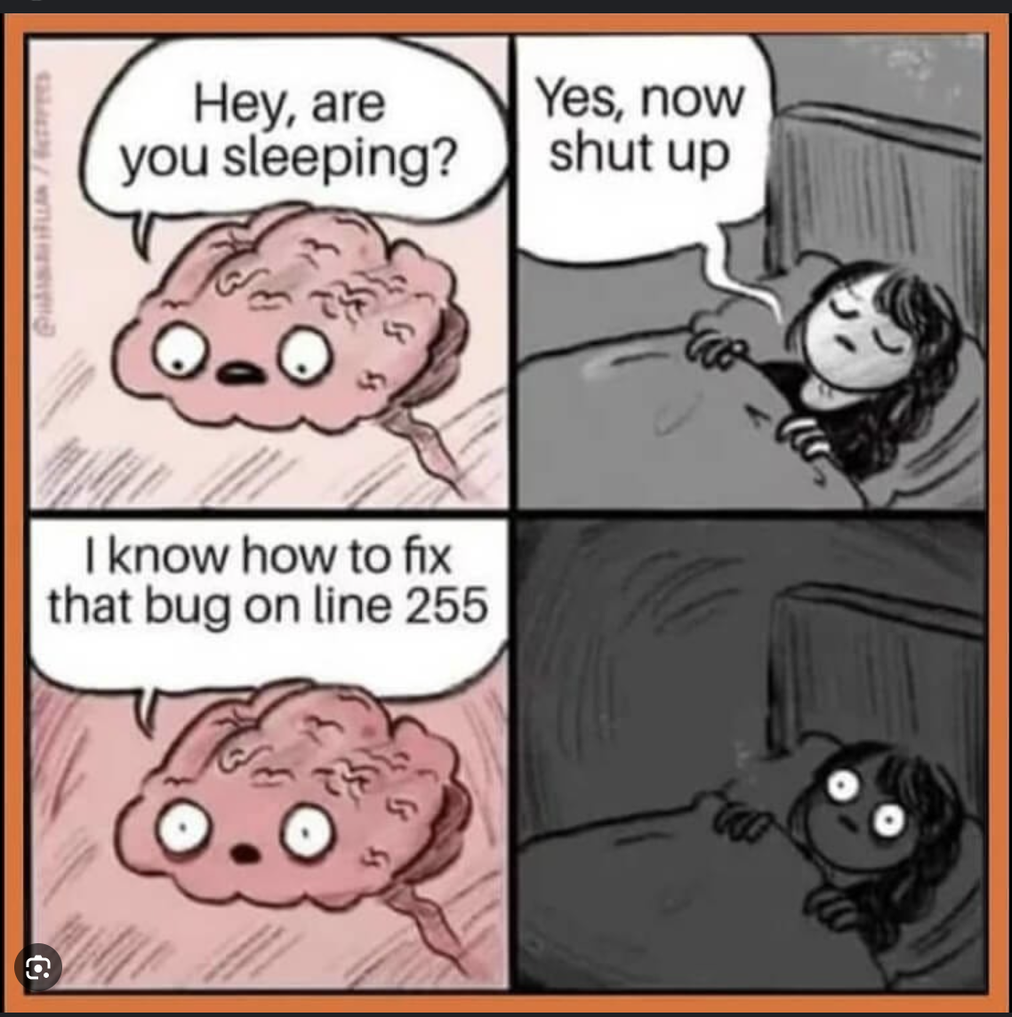
How did we get here?
Monolithic code - single batch, single system, single db.
Changes to one element strongly impacted the whole.
Programmers sometimes preferred to work alone but this limits productivity.
Collaboration not easy.
Image source: Python in Plain English - Jesus Lagarez, Medium
Notes:
HISTORICALLY: one programmer typically wrote a program using a monolithic batch file. This was a single huge list of instructions, usually involving a single database and system and typically read by the computer’s operating system sequentially line by line. The batch file was capable of jumping around a bit in the order of operations (IF THEN GOTO) but essentially it was like a long story. It was easily affected by a single bug and it took a long time to compile and run. To collaborate, the programmer would typically introduce a new programmer to the code and they would take responsibility for different sections of the code and work in such a way that they didn’t save over or affect each other’s code.
Sometimes this didn’t work very well.

Slide 5
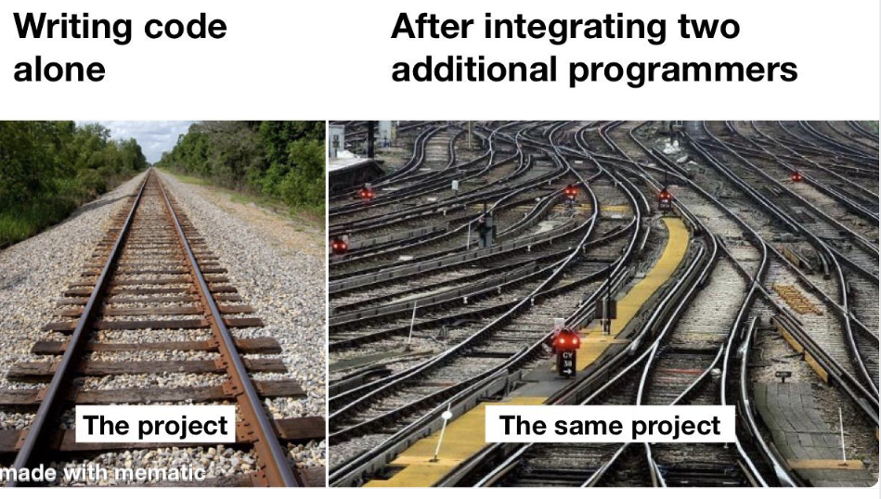
Innovations in Software Engineering
Monolithic code gave way to object-oriented programming.
OOP was developed in the 1960s and 1970s but popularised through languages like Java and C++ in the 1990s.
Classes and routines, more efficient and easier to manage and quicker to run. This helped avoid accidental overwrites.
But sometimes… this still didn’t work very well.
Voila: Git! Invented in 2005 by Linus Torvalds -
who also invented the Kernel of the Linux O/S.
Exciting nerdy fact
Image source: Programmer Humor https://programmerhumor.io/memes/team-collaboration 2025
Notes:
Monolithic code gave way to object-oriented programming. OOP was developed in the 1960s and 1970s but popularised through languages like Java and C++ in the 1990s.
What’s this got to do with it, you say?
Through the use of classes and routines, code became more efficient and easier to manage and quicker to run. Sometimes one programmer, say at a bank, would be assigned to all of the bank’s classes for certain functionalities. This helped avoid accidental overwrites.
But sometimes… this still didn’t work very well.
We have all had the experience of someone overwriting our Word
document. It’s like that but with even more dire consequences.
Voila: Git! Invented in 2005 by Linus Torvalds - who also invented the
Kernel (the core) of the Linux O/S. Pretty much an icon for nerds.

Slide 6
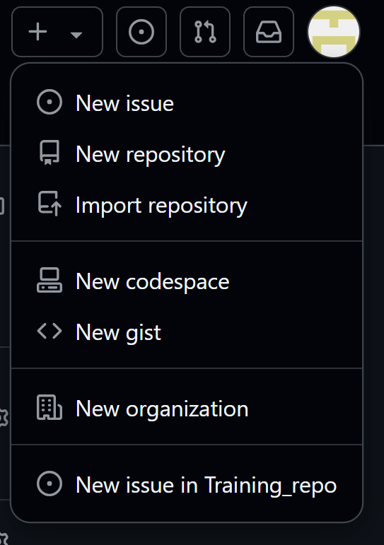
Button is a shortcut to common actions
Plus button near the top right of the screen gives access to many common actions.
Notes:
From here on we show rather than tell - these slides are here for later reference.

Slide 7
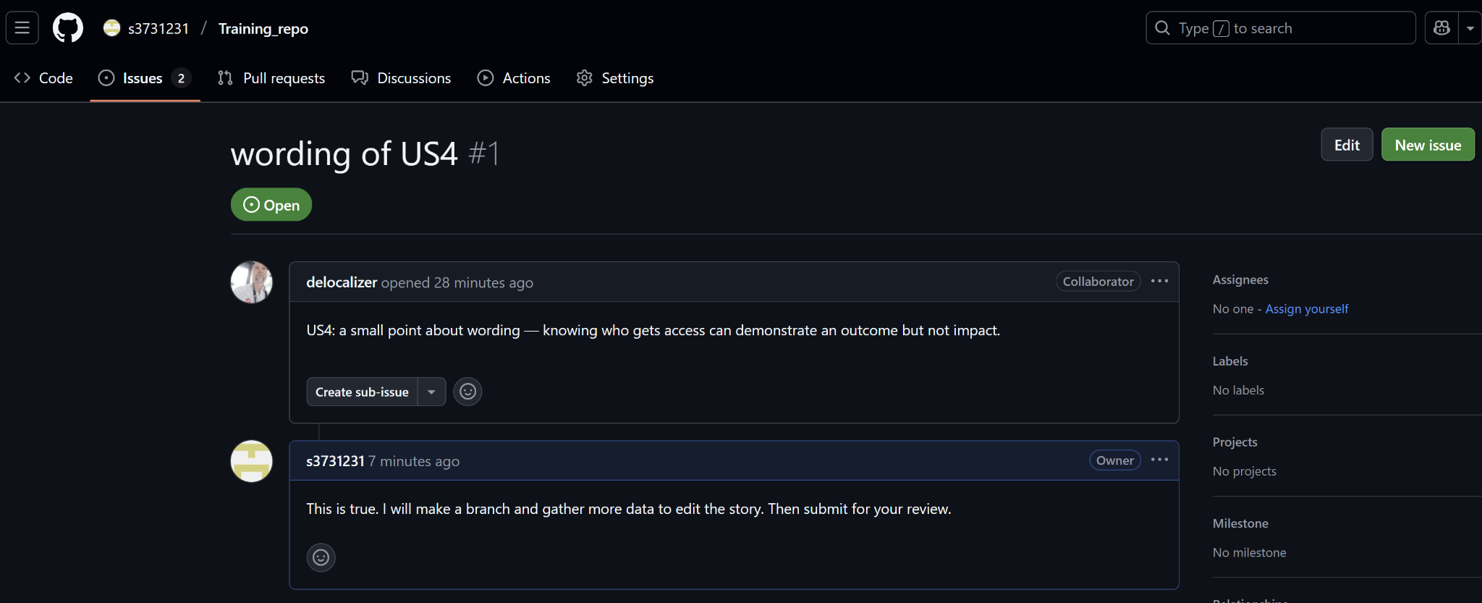
Raising an issue in GitHub
Navigate to Issues then click New Issue or use the + button
Notes:
From here on we show rather than tell - these slides are here for later reference.

Slide 8
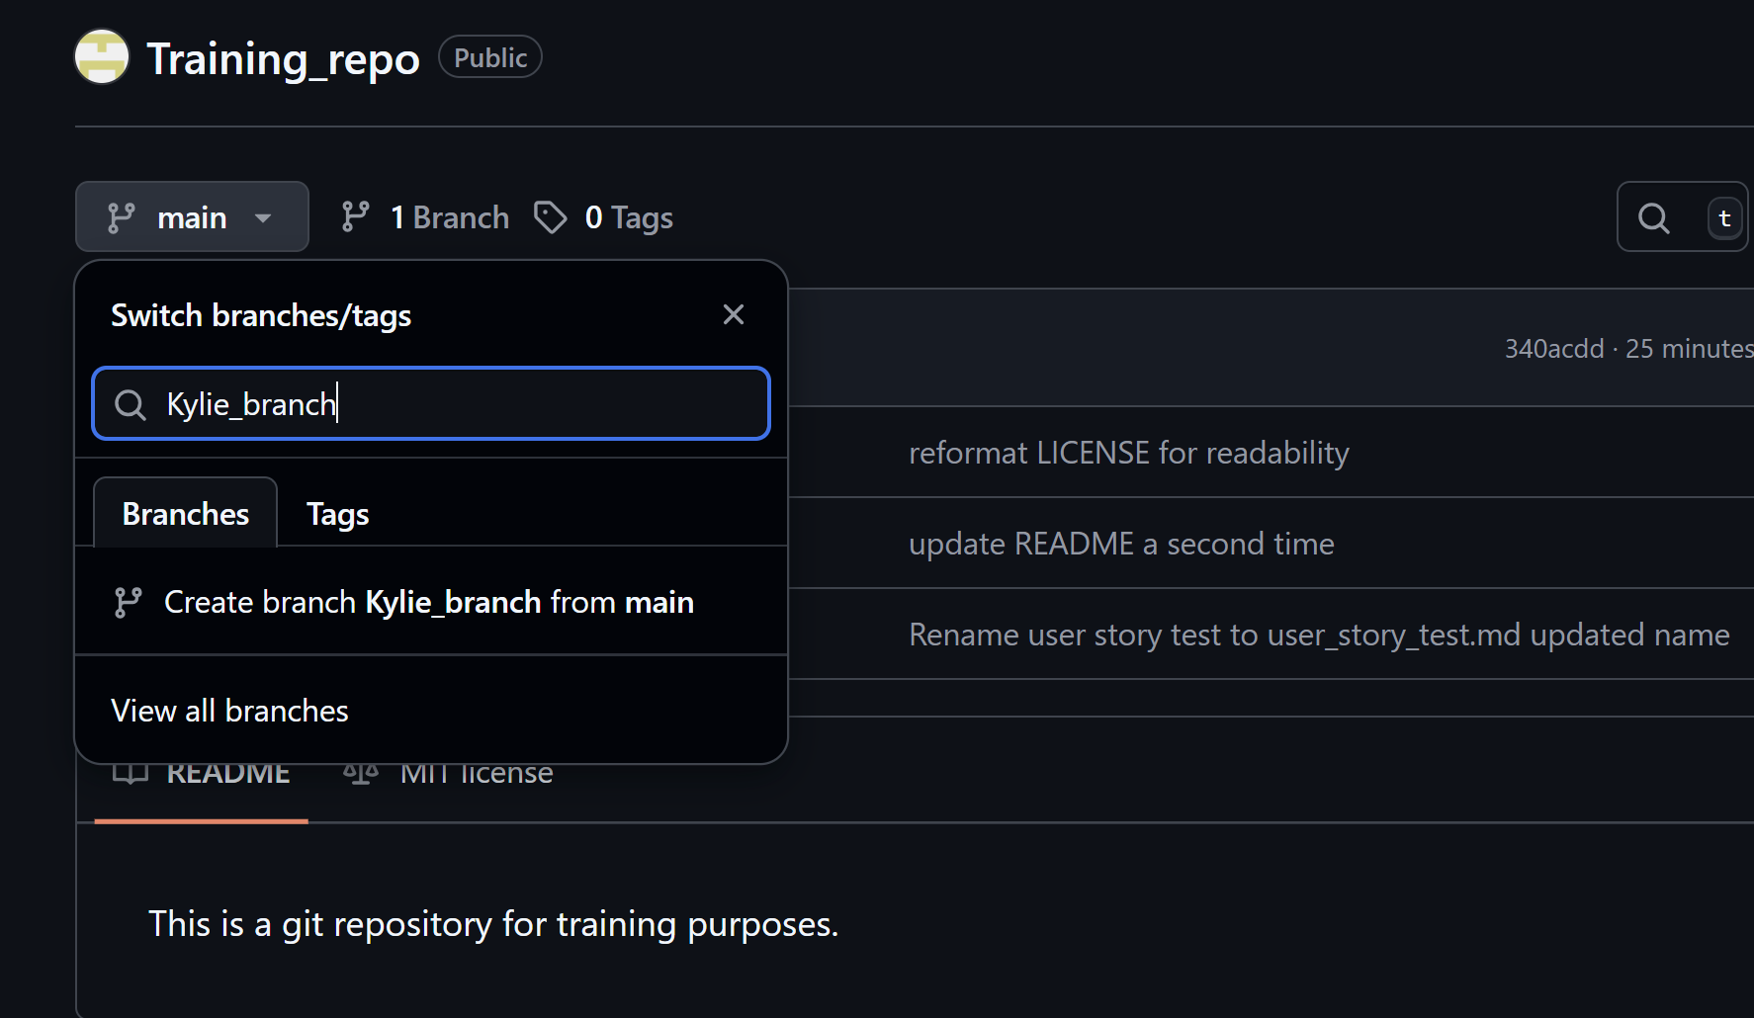
Making a Branch
Click the down arrow next to Main, then type your new branch name in and click
Create branch [branchname] from Main. Your own branch is your own sandbox to try changes.

Slide 9
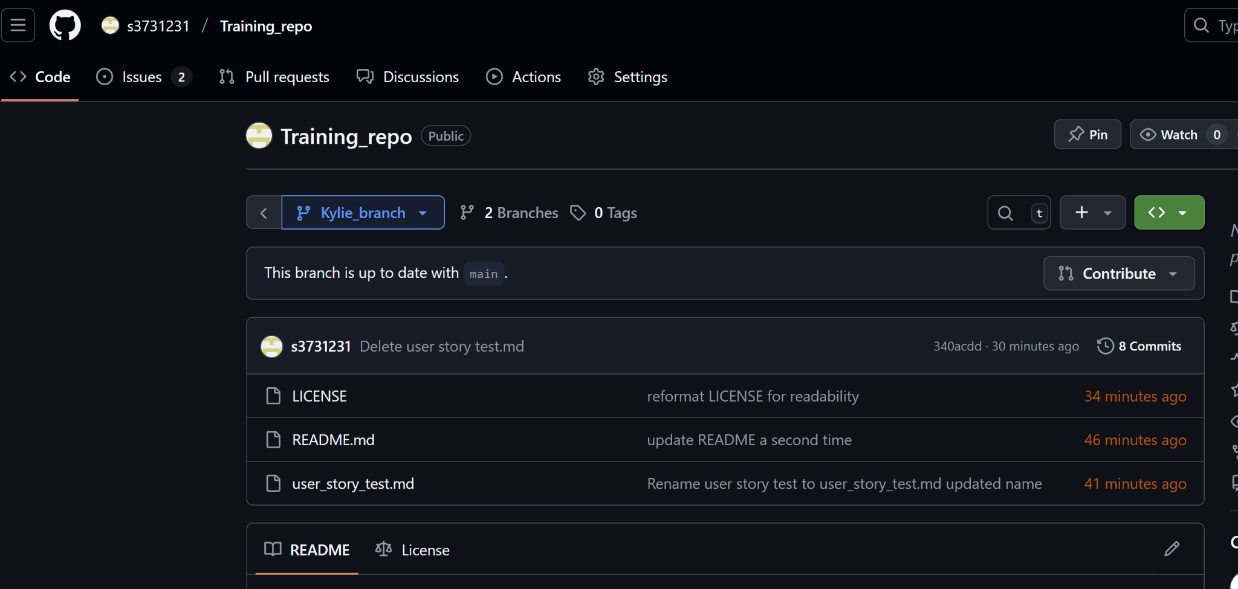
Working in your branch
Always check that you are working in the correct branch - look at the top left under the Repo name. You can switch back and forth between main and your branch.

Slide 10
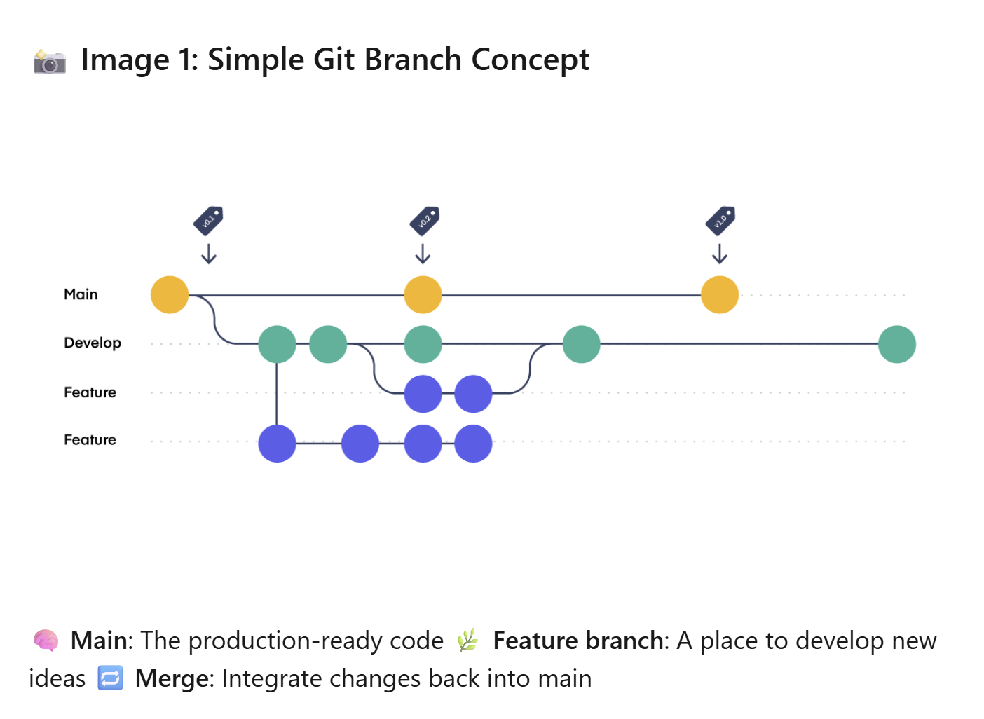
The concept of branches in Git/GitHub
Image source: What is a Branch in Git and Github? By Ashutosh Mankhair - LinkedIn - https://www.linkedin.com/pulse/what-branch-git-github-branching-strategies-explained-mankhair-iwn0f/

Slide 11
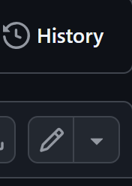
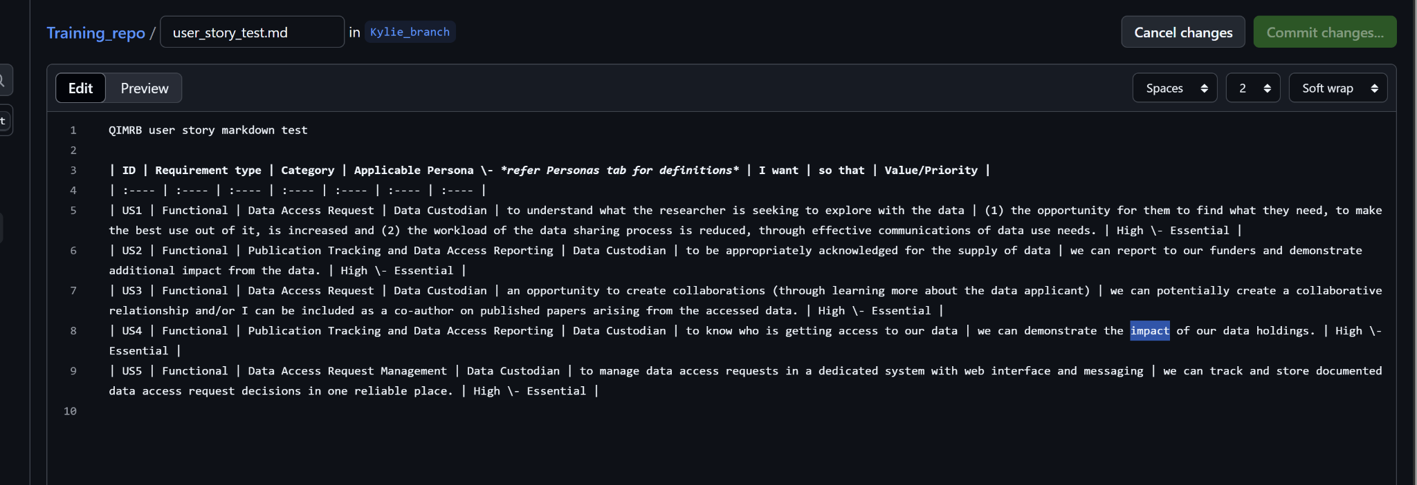
Making edits
Click the pencil icon to edit your file. This file is in markdown (more about that later).
Make your edit then click Commit Changes.
Pencil icon

Slide 12
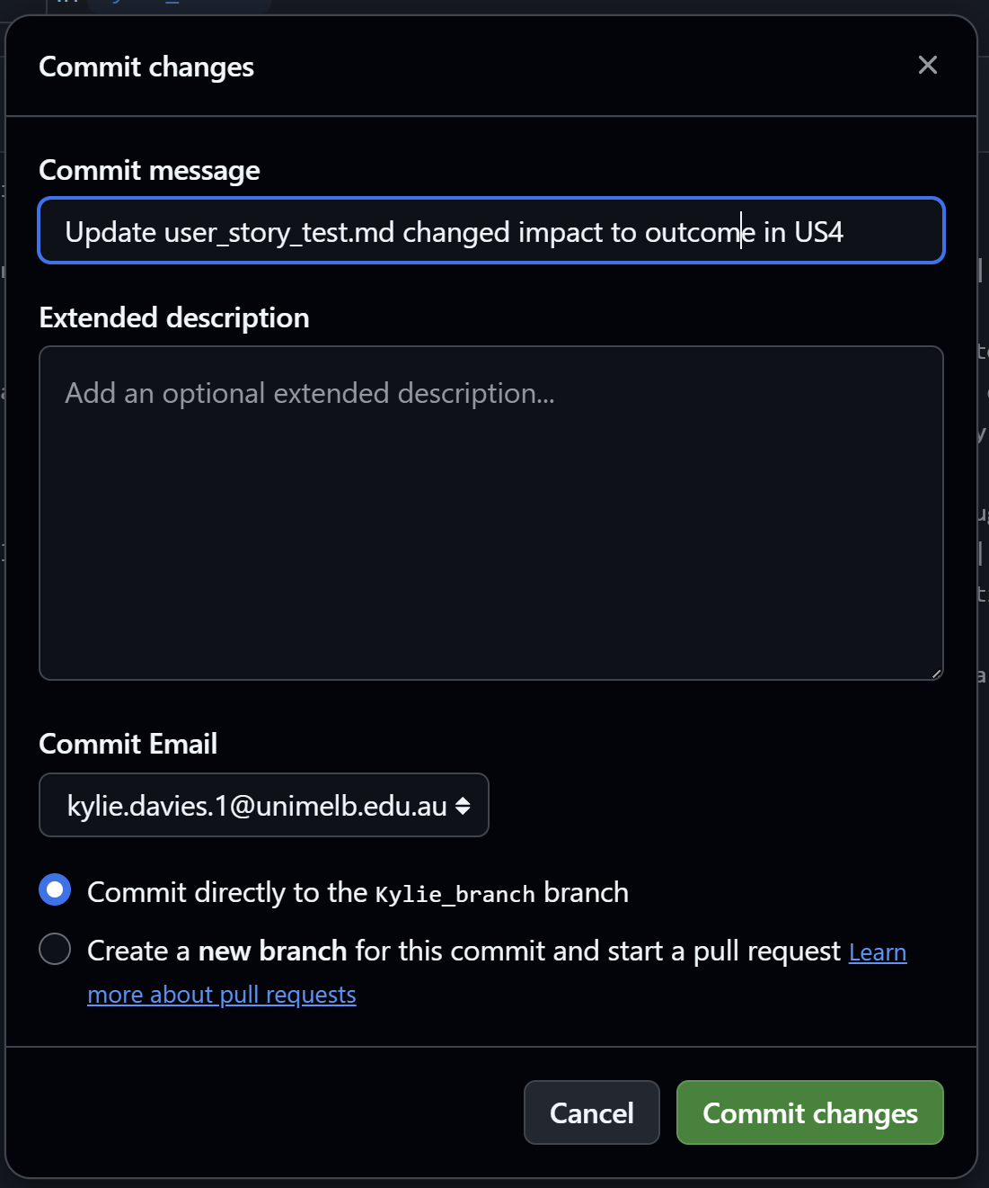
Commit Changes to your branch with a comment
Whenever you commit a change you will be prompted to add a commit message - briefly describe your change - the commit message is mandatory - the extended description is optional and for more detail. This forms the version history saved with the repo. Click Commit Changes again.
(The change is able to
be reverted if needed.)

Slide 13
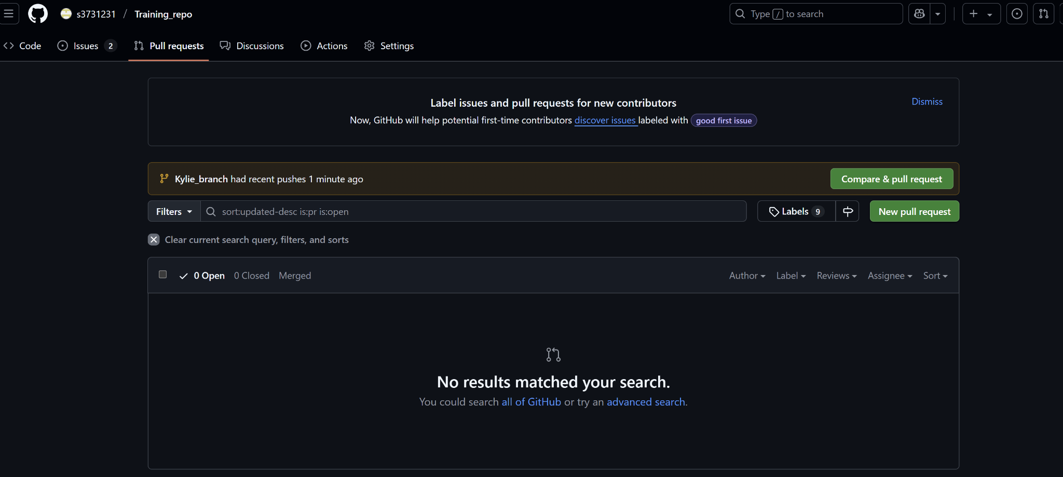
Submitting a Pull Request in GitHub
You may make many commits during an editing session. Then submit those as a pull request. This is a package of changes you submit for approval and merging (potentially) into the main branch. Click Pull Requests and select New Pull Request.

Slide 14
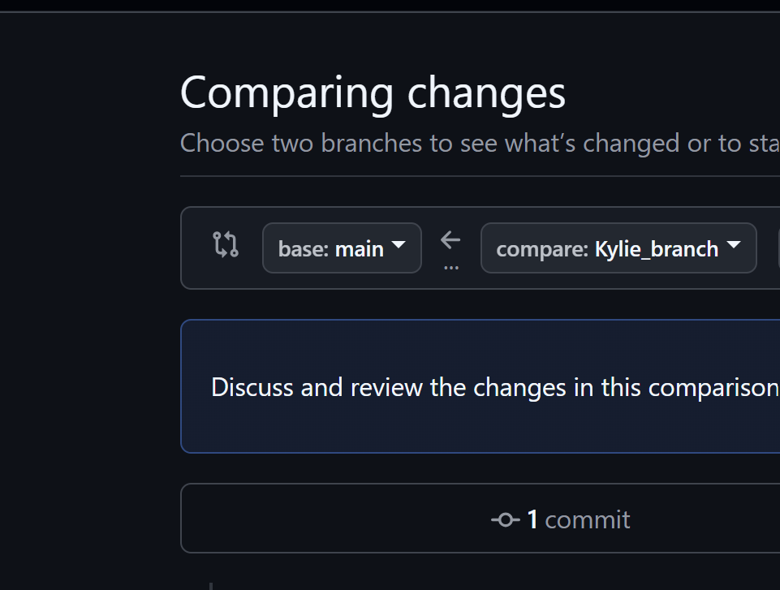

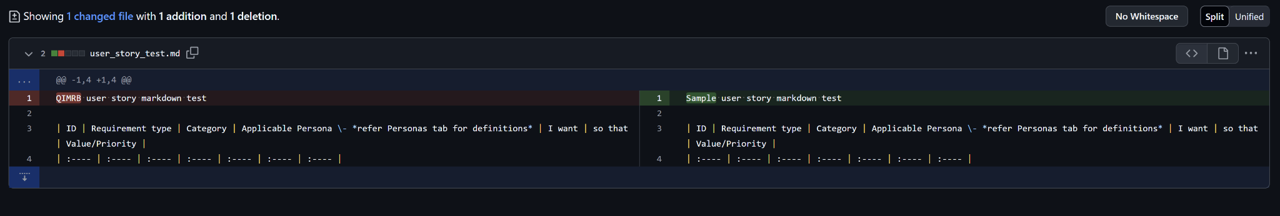
Submitting a Pull Request in GitHub
Set the compare: branch to your branch. A line by line comparison is revealed beneath for you to confirm what has been deeted and added, and the Create Pull Request button is enabled.
Click that.

Slide 15
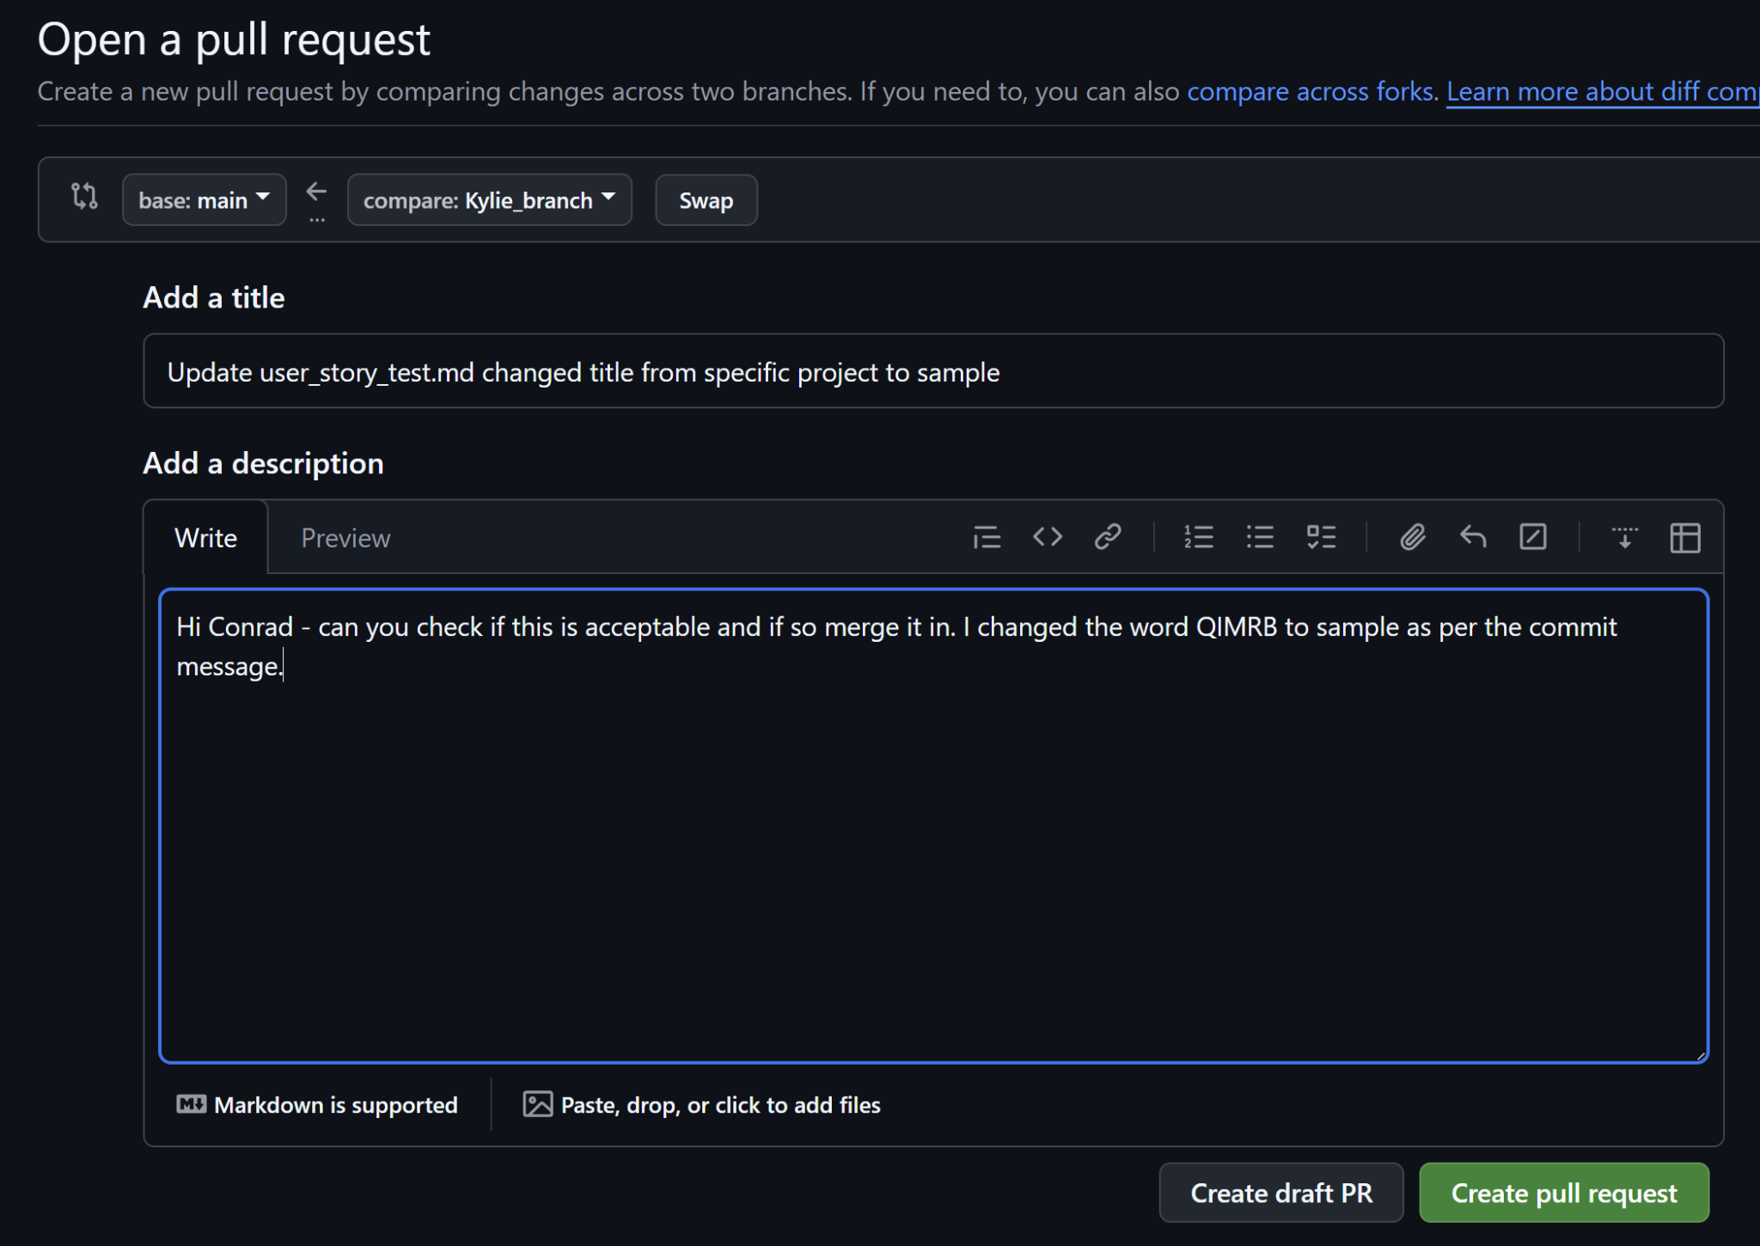
Submitting a Pull Request in GitHub
Add a description for the person who will review and merge the pull request, then again click Create pull request.

Slide 16
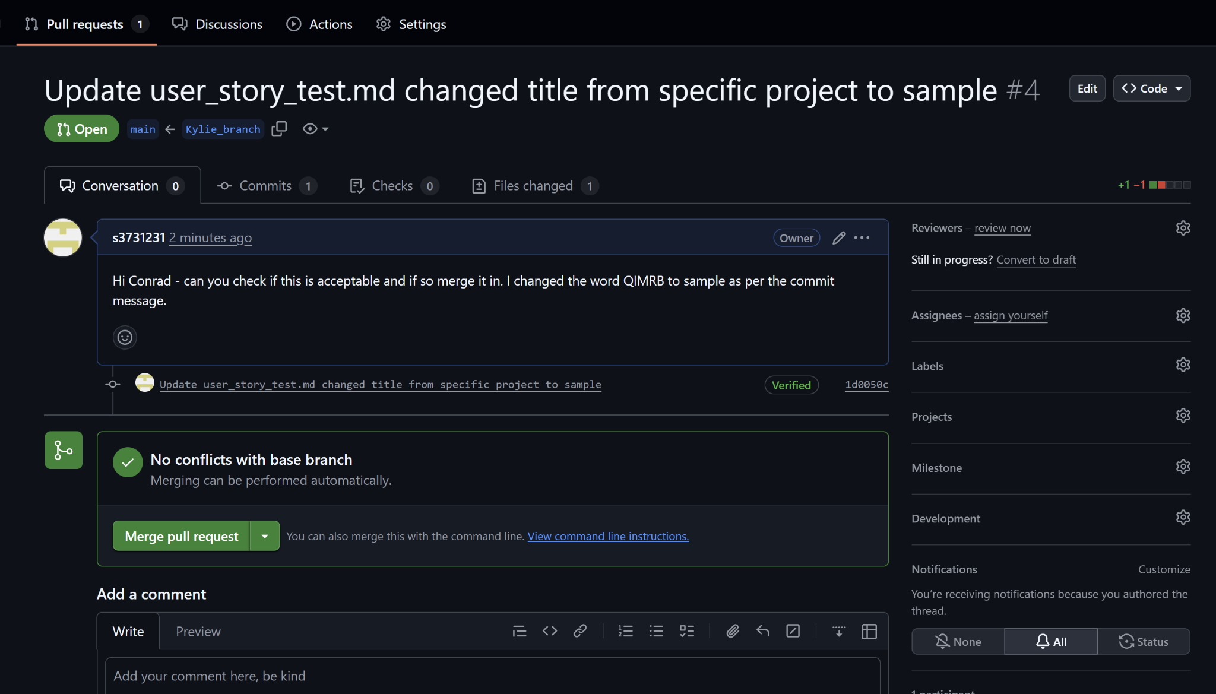
Comparing and Merging
Your collaborator will find your pull request under Pull Requests. They will compare to the main and make a decision on whether to merge your pull request into the main branch. You will be notified once they do. GitHub gives an indication that there are no conflicts and several other features to assist in comparing. Once satisfied, they click Merge Pull Request then can add a comment then click Confirm Merge to bring your package of changes into the Main Branch.

Slide 17
Remember to update & close the Issue
If your package of changes was triggered by an Issue, navigate back to the issue and update the issue with a comment and close it. This lets the issue raiser know you have taken their suggestion onboard and keeps the Issues folder tidy, preventing you or your team-mates working on issues already addressed.

Slide 18
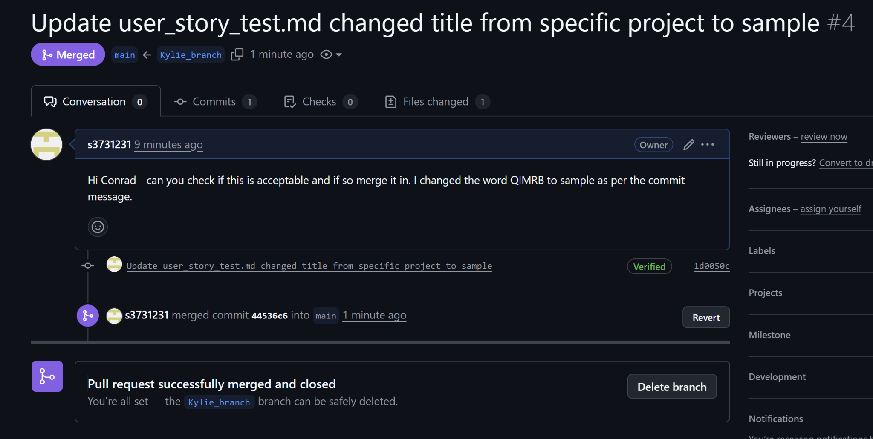
Branch Hygiene - delete your branch
Once your branch has been merged into Main, you need to delete it, because its purpose has been served and it will be out of date once any other pull requests are merged into the Main.
The neat thing about the browser GitHub is that it prompts you immediately after merging to delete your branch with a single click. Create a new branch to create a new suite of changes.

Slide 19
Markdown - a cheat’s guide
In Google docs, you can download a file in Markdown format. This is a shortcut to creating a markdown format file in GitHub through copying and pasting directly into a Git file. A copy of a Google doc and its corresponding markdown file are supplied with these slides.
Remember when creating a new markdown file in Git to give it the file suffix *.md so that GitHub displays the markdown file neatly.

Slide 20
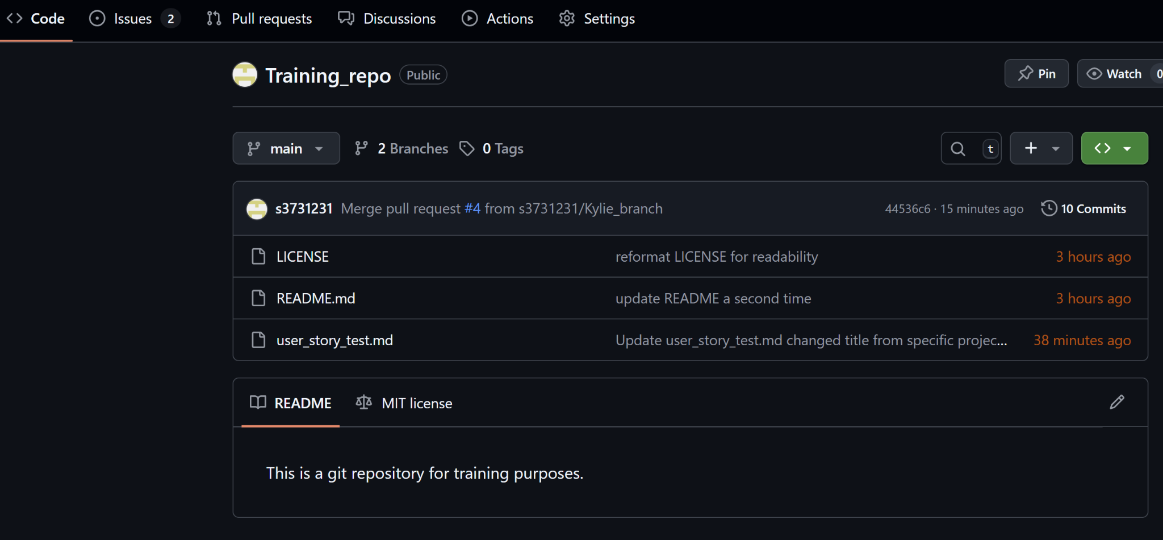
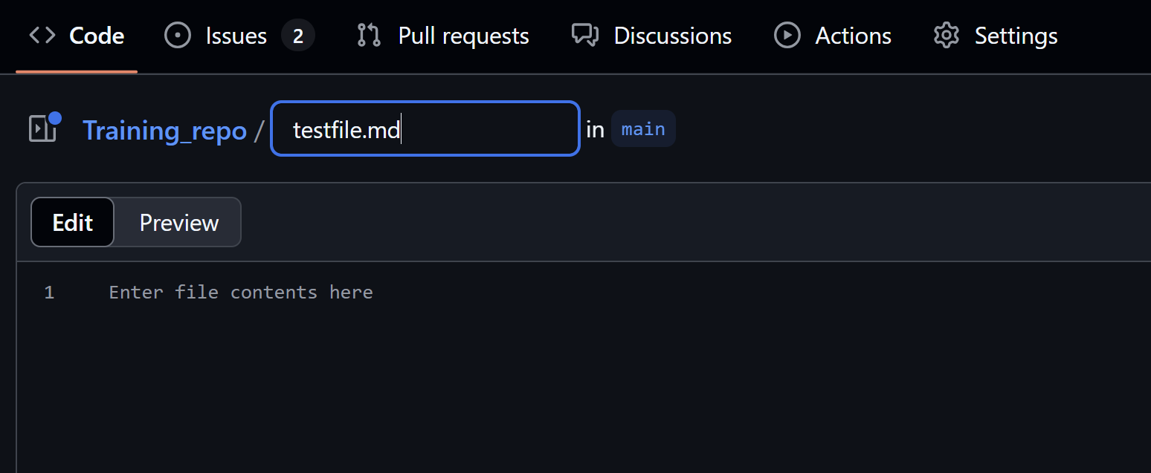
Create a file and edit in markdown
From the Code screen Click the + above the list of files to add a file. Remember to add .md to the name to indicate markdown format. Using our cheat file copy and paste the content then
click Commit Changes.
(To create a folder: add a slash to the name then enter a filename - the folder and file will be created simultaneously.)

Slide 21
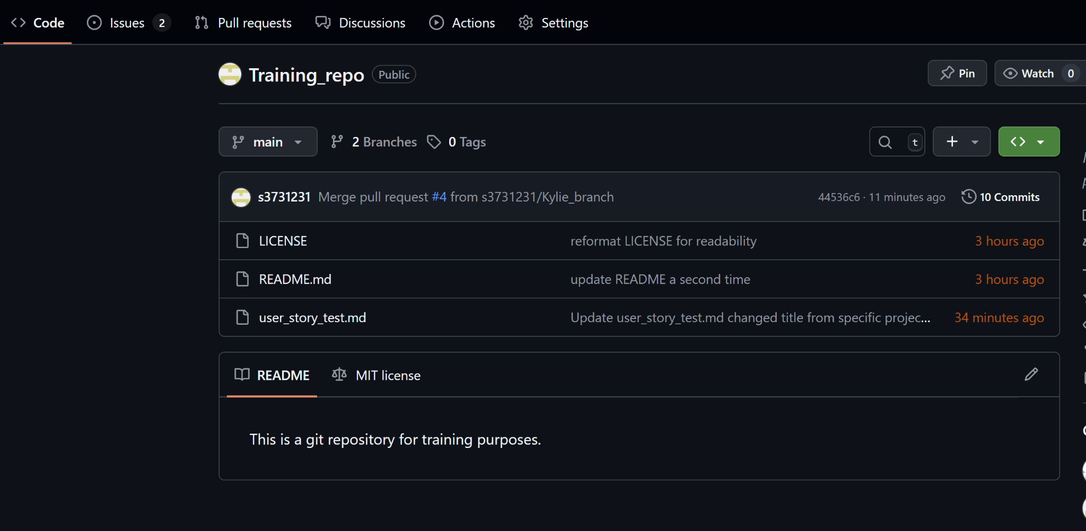
Looking at the commit (version) history

Slide 22
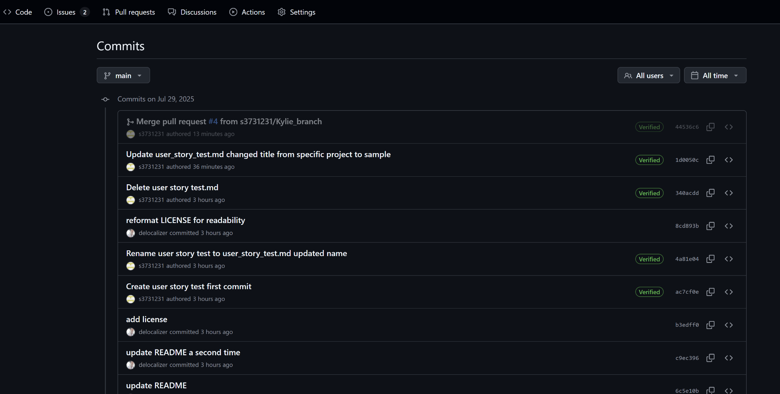
Looking at the commit (version) history

Slide 23
Recommended Resources
CLI novice course https://swcarpentry.github.io/git-novice/
Make a repo in the browser https://www.linkedin.com/learning/github-essential-training-1-the-basics/making-a-repo-in-the-browser?u=2251738
Create an issue in the browser https://www.linkedin.com/learning/github-essential-training-1-the-basics/creating-an-issue?resume=false&u=2251738
Markdown course https://www.linkedin.com/learning/learning-gitlab-25489521/markdown-basics?u=2251738

Slide 24

Connecting with Australian BioCommons
Want to learn a new skill?
Participate in an online workshop or watch a webinar recording: biocommons.org.au/webinars-workshops
Looking for events, jobs, training opportunities and news?
Subscribe to the BioCommons monthly e-news: biocommons.org.au/news
Want to help design relevant bioinformatics infrastructure and services?
Join a researcher community that convenes around your methodology: biocommons.org.au/domains
Interested in delivering training?
Collaborate via the National Bioinformatics Training Cooperative: biocommons.org.au/trainingcooperative

